Slide 1
System
Miami
By: Evethalie StLouis and Layla Hoey

Slide 2
01
Overview

Slide 3
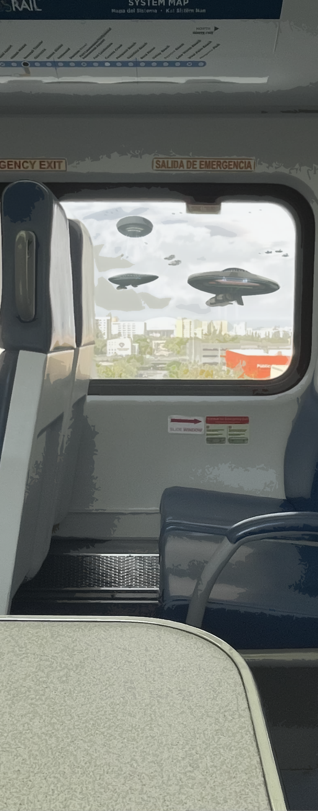

[System Miami] is a 2D RPG-meets-Roguelike Game. The player gets the stats, story and adventure of an RPG with Roguelike systems and mechanics.
The player wakes up to find that aliens have imposed a video game system on all of Earth.
Tutorial - After an unsuccessful encounter with a Giant Alien spider who has taken their little sister captive, our protagonist is rescued by a kind stranger.
Two years later they wake from a coma to find that humanity has integrated into The System.
In this post-apocalyptic world, the Player’s main objective is to survive combat encounters while searching Miami to find their little sister.
“The Cull” - The System is issuing a warning that all humans below a certain Experience Level by the end of the week will be “culled.” The others will transported to the Andromeda Utopia with their families.
In the end, the player finds their family and is able to get the transport, but not all is as it seems.

Slide 4
03
Objectives

Slide 5
Core Loop
Enter Neighborhood -->
Complete Combat Encounters -->
Level up/getting stronger -->
Reach XP Threshold -->
Next Neighborhood (harder combat)

Slide 6
Winning
Reach the final Neighborhood
Defeat the Final Boss.
Losing
Death in a Combat Encounter means starting over at the beginning of the Neighborhood
Player state resets to what it was on entry to the Neighborhood
Encourages the player to try many different strategies and mechanics.
Notes:
Bigger text

Slide 7
04
Mechanics / Systems

Slide 8
Environment Systems
Procedural Isometric Tilemap Environment Generator
Generation Rule
Generation Ruleset
Rule-prioritization System
Overworld Rulesets
Neighborhood Ruleset
Intersection Ruleset
Building Ruleset
Building Storey Tile Ruleset
Combat Room Rulesets
Floor Ruleset
Wall Ruleset
Game Board Tile Rulesets

Slide 9
Player Systems
1
Simple Character Creator
8-Direcitonal Movement (free)
8-Directional Movement (locked to tile grid)
Player-Character “Classes”
Fighter
Rogue
Tank
Mage
Attributes (Determined by Player “Class”)
Stats (Determined by Player Attributes)
Inventory
Slot System for “Equipped” Abilities & Items
Resource (recharges per Combat Encounter)
Stamina (for Physical Abilities)
Mana (for Magical Abilities)
Health?
Resource (non-recharging, i.e. Currencies)
Currency (purchase Items)
Ability Points (purchase Abilities)
Attribute Points (purchase attribute upgrades)
Health?
Leveling System
EXP (level-up. Threshold scales)

Slide 10
Player Systems (Resources)
2
Resource | Used for … |  | Obtainment
Stamina | performing | Physical Abilities | refills | per Combat Encounter
Mana | performing | Magical Abilities | refills | per Combat Encounter
Speed | moving | Player to a Tile | refills | per Turn
Health | [ s t a y a l i v e ! ] |  | Health Items | Other obtainment methods TBD -- Reward for Leveling Up? Reward for Completing Neighborhood?
Currency | purchasing | Items | reward | for Combat Encounter
Ability Points | purchasing | Abilities | reward | for Combat Encounter
Experience Points | leveling-up | Player (threshold scales) | reward | for Combat Encounter
Attribute Points | upgrading | Attributes | reward | for Leveling-Up

Slide 11
Combat Systems
1
Difficulty System - Easy, Medium, Hard encounters.
The difficulty of each of these increases in each Neighborhood.
The gap in difficulty between the three scales up with each new Neighborhood.
Turn System
Move Player
Use Ability or Item
Ability System
Physical (name?)
Magical (“Spells”, “Spellcasting”)
Some abilities will be obtainable by all “Classes”
Some abilities will be exclusive to a certain “Class”
Item (e. g. Gain Health, Boost Attack, etc.)

Slide 12
Combat Systems
2
Enemy AI
Simple search-and-destroy logic.
Enemy Generation
Enemy starting positions are random (but never on the Side of the Game Board where Player starts the Encounter).
Enemy Types are randomly chosen from a Pool
The Types of Enemies in the Enemy Pool are determined by current Neighborhood
Enemy Stats are randomized in a range.
The range of Enemy Stats is determined by number of successfully-completed Neighborhoods.

Slide 13
UX / UI Systems
General
Pause Menu
Saving System
A/V Settings
Overworld
Mini-map
Camera Zoom System (fluid or toggle?)
Combat
Turn Status Panel
Collapsable Player-Controls Panel
Collapsable, Cycling Enemy-Information Panel

Slide 14
05
Audience & Platform

Slide 15
Our audience is both the RPG and the roguelike community. We aim to achieve:
The grinding and measurable progress of RPGs, with emphasis on players’ ability to sculpt their experience.
The engaging loop of “runs” in Rogulikes, and the satisfaction of finally beating a punishingly difficult one.
We seek to create a simple but immersive game world that speaks to the hearts of these types of gamers.

Slide 16
Thank You

